Slide 1
Data Science Talk: Data Cleansing
August 26 2019
Analytics and Data Science
Analyse et Science des données

Slide 2
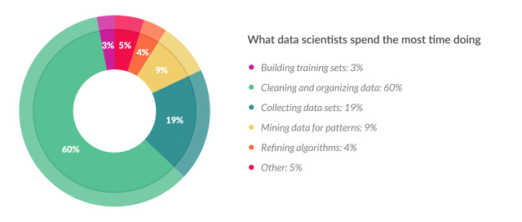
Data Science Time Breakdown
80% of time is spent on data collection and cleansing
Image source: https://whatsthebigdata.com/2016/05/01/data-scientists-spend-most-of-their-time-cleaning-data/
80/20 rule: https://www.ibm.com/cloud/blog/ibm-data-catalog-data-scientists-productivity

Slide 3
Overview
1
Reading in data
2
Data Standardization
3
Missing Data
4
Discussion

Slide 4
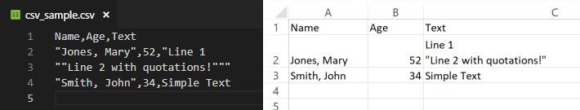
Data Loading
Delimited text files (.csv, .tsv, etc)
Data values are separate by a delimiter
Tab, comma, space etc.
Usually a quote character to handle fields containing the delimiter
And an escape character e.x. from Excel – “Jones, Mary”,
Most programs dealing with data can import/export these formats
Aren’t space efficient and don’t include type information

Slide 5
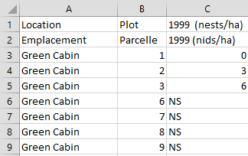
Data Loading
Structure of text and Excel files
Ideal Case :
Header first row
Data in following rows
Many data structures created by and for humans are not like this!
Issues requiring extra attention:
Headers across multiple rows
Explanatory information
Extra spacing
Rows for subtotals, totals
Multiple tables in one sheet or file

Slide 6
Data Loading
Example of text import functions
Separator | Python (Pandas) | R (Base) | R (Readr)
Comma | pd.read_csv | read.csv | read_csv
Tab | pd.read_table | read.delim | read_tsv
Semicolon (with comma decimal) | Either function, set sep and decimal options | read.csv2 | read_csv2
Generic (specify delimiter) | Either function, set sep option | read.table | read_delim
Fixed Width | pd.read_fwf | read.fwf | read_fwf
Whitespace | Either function, set sep as “\s+” | read.table | read_table

Slide 7
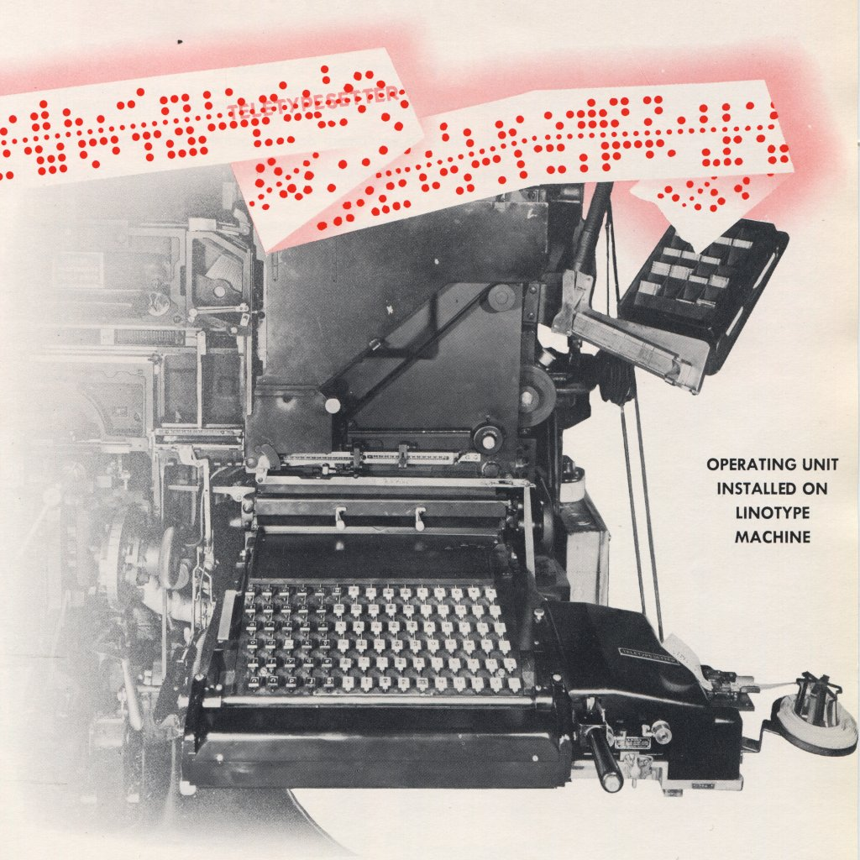
Data Loading
File Encodings
How computers map text to binary data
Encodings generally include visible characters as well as “control characters” which date back to Teletype machines
Reading in a file with the wrong encoding :
an error
replacement characters (�)
visual representations of the byte
<U+0093>, \u0093
garbled text known as “mojibake”
(DÃ‰PENSES instead of DÉPENSES)

Slide 8
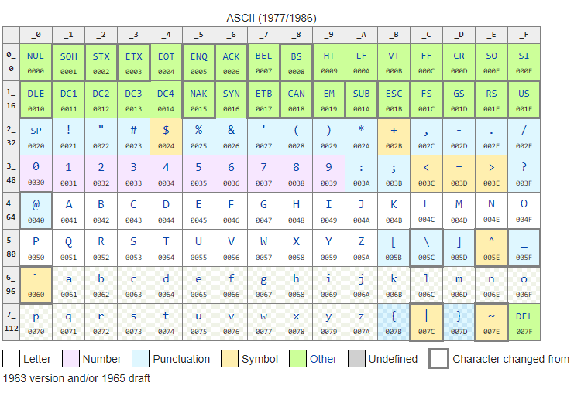
Data Loading
Example of ASCII encoding

Slide 9

Data Loading
Common encodings
Common encodings
English and French
Web Standard
Latin1
ISO-8859-1
Based on an ASCII extension
Windows Western European Code Page
Windows-1252
A superset of Latin1, contains additional characters
(ex. “– — € )
Unicode Transformation Format- 8 bit
UTF-8
Multilingual, mathematical, scientific and even emojis
Unicode with backwards compatibility to ASCII
General
Characters in the ASCII range will normally decode properly

Slide 10
Standardization

Slide 11
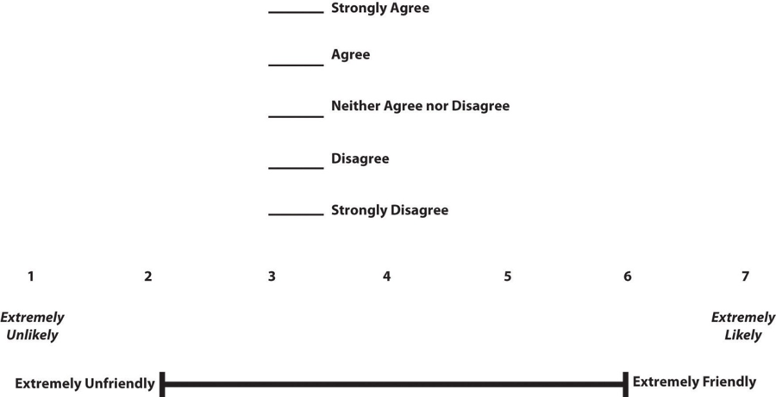
Data Standardization
Ensure all values mean the same from one row to the next.
Important when combining data sources, or when data model has changed over time.
0
5

Slide 12
Data Standardization
Inconsistent Coding
Entries that mean the same thing should use the same name/label
Different syntax:
Standardize text
E.x. “ottawa” “Ottawa”
Different semantics:
Use coding that can represent everything.
Ex. Combine the two datasets using the following scales
{1: Male, 0: Female}
{'M': Male, 'F': Female, 'U': Unknown}
Adopt the second scale for as it can handle “unknown”

Slide 13
Data Standardization
Invalid Values
Use a list of valid codes if you can find or make one
Visually inspect unique category values
Ex. CS-09 group
Add a data validation step to data pipelines to detect breaks when they occur — and they will!
Log changes to categorical values and new attributes
Error out if significant changes — no silent pass-through

Slide 14
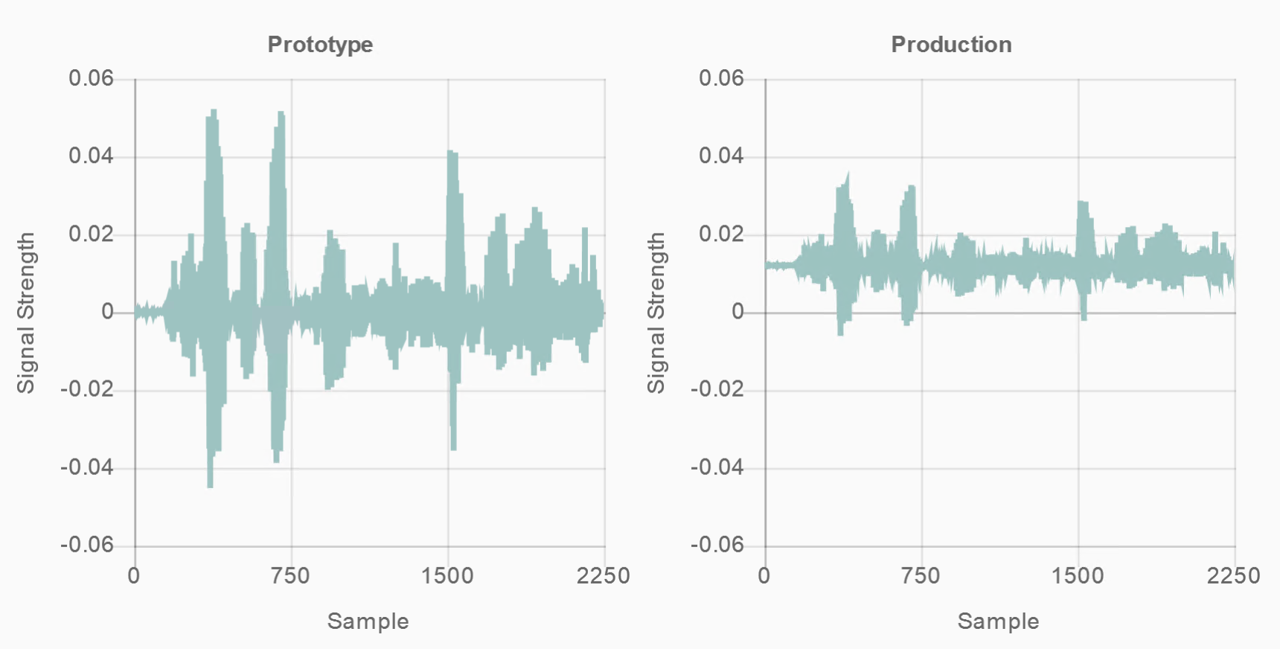
Data Standardization
Numeric Values
For numeric attributes, especially time series, it’s important that the values are comparable across rows.
Three common steps to consider:
Normalization
Standardization
Outlier Handling
Difference between training and production data
Some other examples: https://cloud.google.com/dataprep/docs/html/Normalize-Numeric-Values_57344585

Slide 15
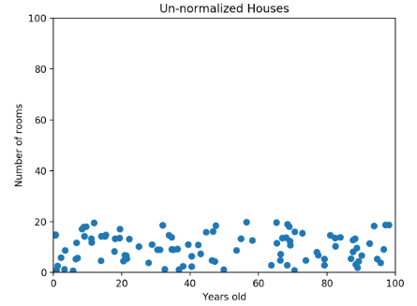
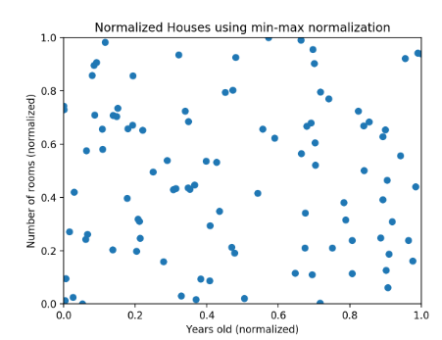
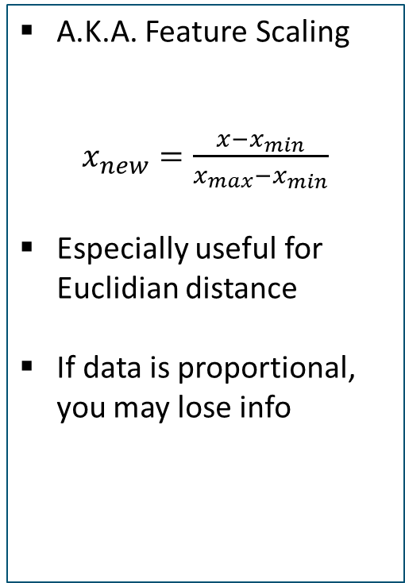
Data Standardization
Numeric Values
Normalization
A.K.A. Feature Scaling
$x_{new}=\frac{x−x_{min}}{x_{max}−x_{min}}$
Especially useful for Euclidian distance
If data is proportional, you may lose info
Image source and examples: https://www.codecademy.com/articles/normalization

Slide 16
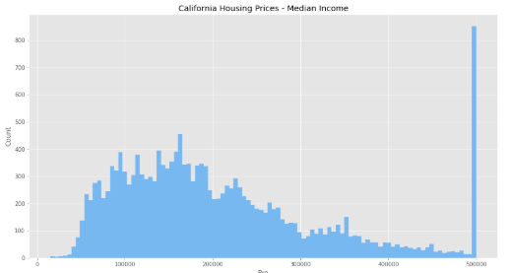
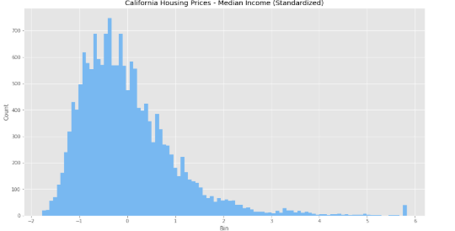


Data Standardization
Numeric Values
Standardization
Normalization
Transforms all values to zero mean and unit variance
$$x_{new}=\frac{x−μ}{σ}$$
Useful for features with different units, or scales
*Note: µ is mean
σ is std. deviation
A.K.A. Feature Scaling
$x_{new}=\frac{x−x_{min}}{x_{max}−x_{min}}$
Especially useful for Euclidian distance
If data is proportional, you may lose info
Image source, Examples: https://medium.com/@rrfd/standardize-or-normalize-examples-in-python-e3f174b65dfc

Slide 17
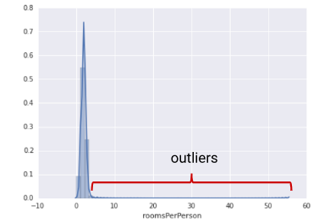
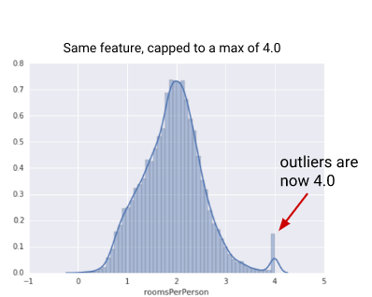
Data Standardization
Numeric Values
Normalization
Outliers
A.K.A. Feature Scaling
$x_{new}=\frac{x−x_{min}}{x_{max}−x_{min}}$
Especially useful for Euclidian distance
If data is proportional, you may lose info
Remove or impute values that lie outside threshold.
Common methods:
Use knowledge to set threshold
Z-score or sliding window (1 attribute)
DBSCAN or Isolation Forest (mult. Attributes)
Image Source: https://developers.google.com/machine-learning/data-prep/transform/normalization

Slide 18
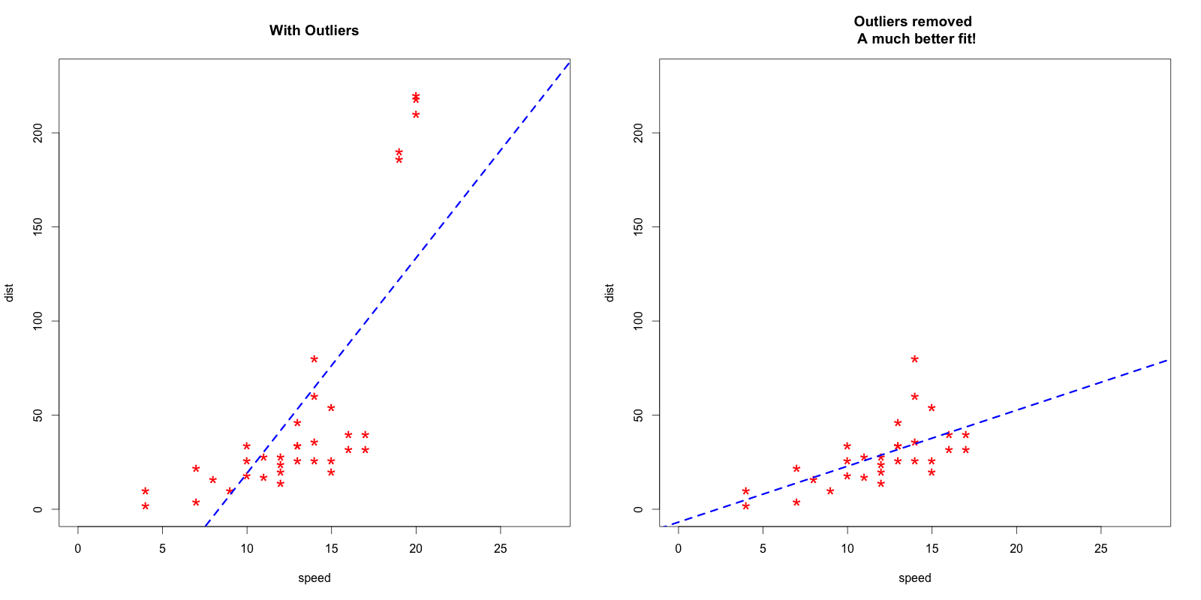
Data Standardization
Numeric Values
Normalization
Outliers
Effect of outliers on regression

Slide 19
Data Standardization
A Case for Master Data
Many of these problems stem from the fact that entities are mapped to application-specific IDs, and not to “master”, or “reference” IDs, e.g.
Countries, Provinces, Territories & Cities
Federal Depts / Agencies / Crown Corps
PRIs, Business Numbers, etc.
There is ongoing work on this, and definitely worth keeping an eye on.
Check out on GCConnex:
Reference Data Management Working Group

Slide 20
Missing Values

Slide 21
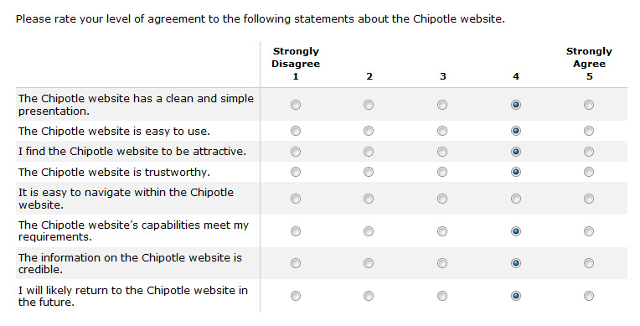
Missing Data
Reasons for missing data
Error in the data collection process
Certain measurements are not applicable
Fields left blank (intentionally, or unintentionally)
Image source, examples: https://measuringu.com/handle-missing-data/

Slide 22
Missing Data
Reasons for handling missing data
Most tools are unable to handle missing data
Missing values can produce unpredictable results
How to identify :
Blank cells, or cell with whitespace
Placeholder strings
NaN (Not a Number)
NULL value
Often used in relational databases
Types of missing data:
Missing at random
Missing completely at random
Missing not at random
Removing this type of data may introduce bias

Slide 23
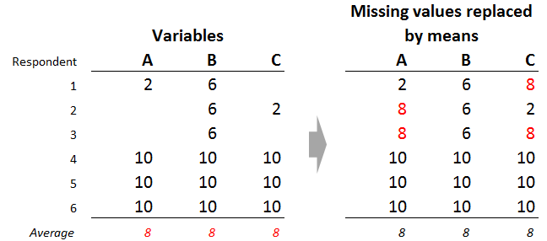
Missing Data
Techniques to deal with missing values
Eliminate Samples or features with missing values:
However, this is not ideal for certain datasets
Impute missing values:
Replace missing value with mean, median, most-frequent value of the entire feature column.
Useful for categorical values
Fill with 0 or specific number:
Only use if there is an expected value, or extensive dataset knowledge
Average
Image Source: https://www.displayr.com/5-ways-deal-missing-data-cluster-analysis/

Slide 24
Discussion

Slide 25
Github Code Examples

